Slide 1


CRICKET MANAGEMENT SYSTEM
BY:
KISHORE KUMAR S 23CDR075
KISHORE NARANDHERAN S P 23CDR076
PARTHA SARATHI M 23CDR116
Review – 3 : 26/04/2025

Slide 2
Problem Description
Manual processes make tournament management slow and error-prone.
Team, player, and match data are not centrally organized.
Real-time updates for scores and schedules are missing.
No structured access for different user roles like admin, coach, and player.

Slide 3
Objectives
To centralize and simplify the management of teams, players, and match details.
To maintain accurate and organized records of player statistics and match results.
To provide easy and secure access to data for different user roles like admins, coaches, and players.
To reduce manual effort and minimize errors in tournament management.
To support better decision-making through quick retrieval of relevant information.
3

Slide 4
Types of Modules
User Management
Team Management
Player Management
Match Management
Tournament Management
Reports and Analytics
Data Storage and Retrieval
Schedule Management
4

Slide 5
Tech Stack
PYTHON
MySQL
HTML
CSS
XAMPP
5

Slide 6
Proposed System
A centralized platform to manage all cricket tournament-related data.
Allows admins to create teams, schedule matches, and enter match results.
Coaches can access team and player information to manage lineups and view performance.
Players can log in to view their profiles, match participation, and statistics.
Ensures role-based access control to keep data organized and secure.
Enhances overall efficiency, accuracy, and coordination during tournaments.

Slide 7
Advantages
Simplifies the management of teams, matches, and player data.
Reduces manual work and chances of human error.
Provides structured and easily retrievable data.
Disadvantages
Cannot provide live updates or real-time online access.
Data sharing between devices is limited without network support.
System must be manually updated if multiple users need access

Slide 8
Feasibility
Technical Feasibility: The system runs as a standalone application without needing internet or hosting services.
Operational Feasibility: Easy to use with minimal training for admins, coaches, and players.
Economic Feasibility: Low-cost development and no ongoing expenses like hosting or subscriptions.
Legal Feasibility: The system handles only general sports data, so there are no legal concerns.

Slide 9
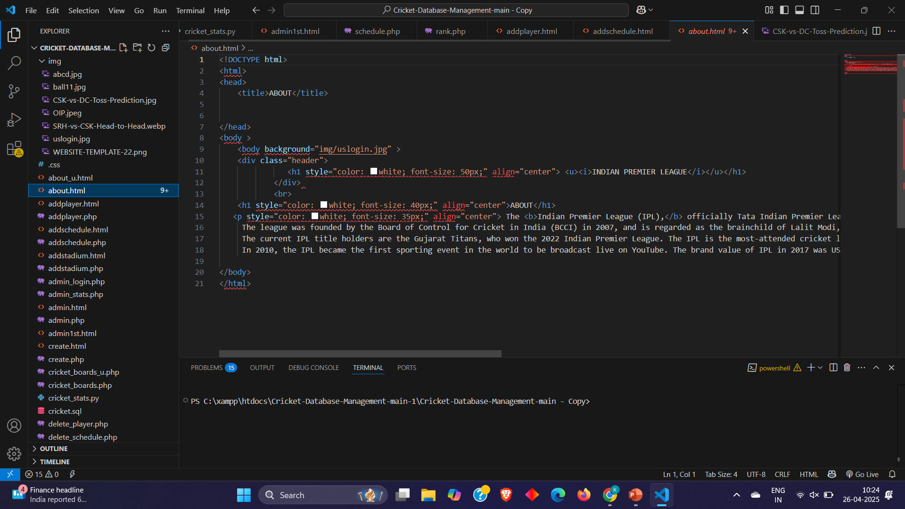
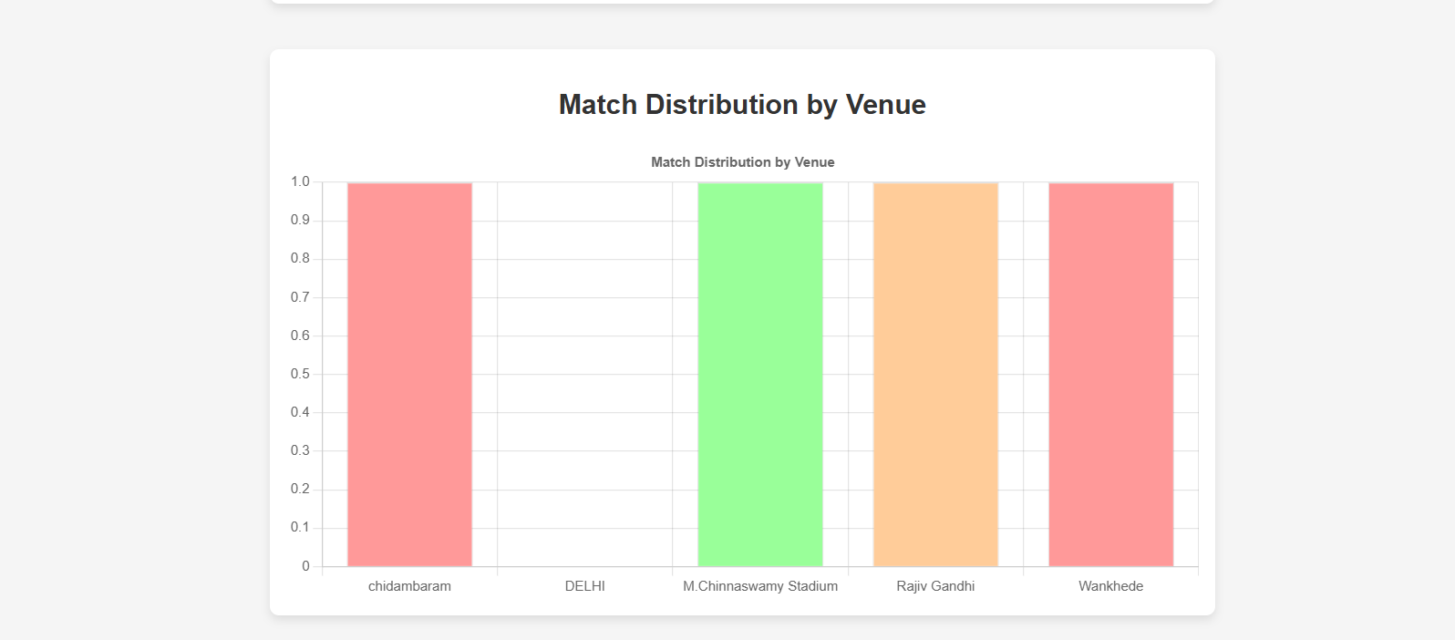
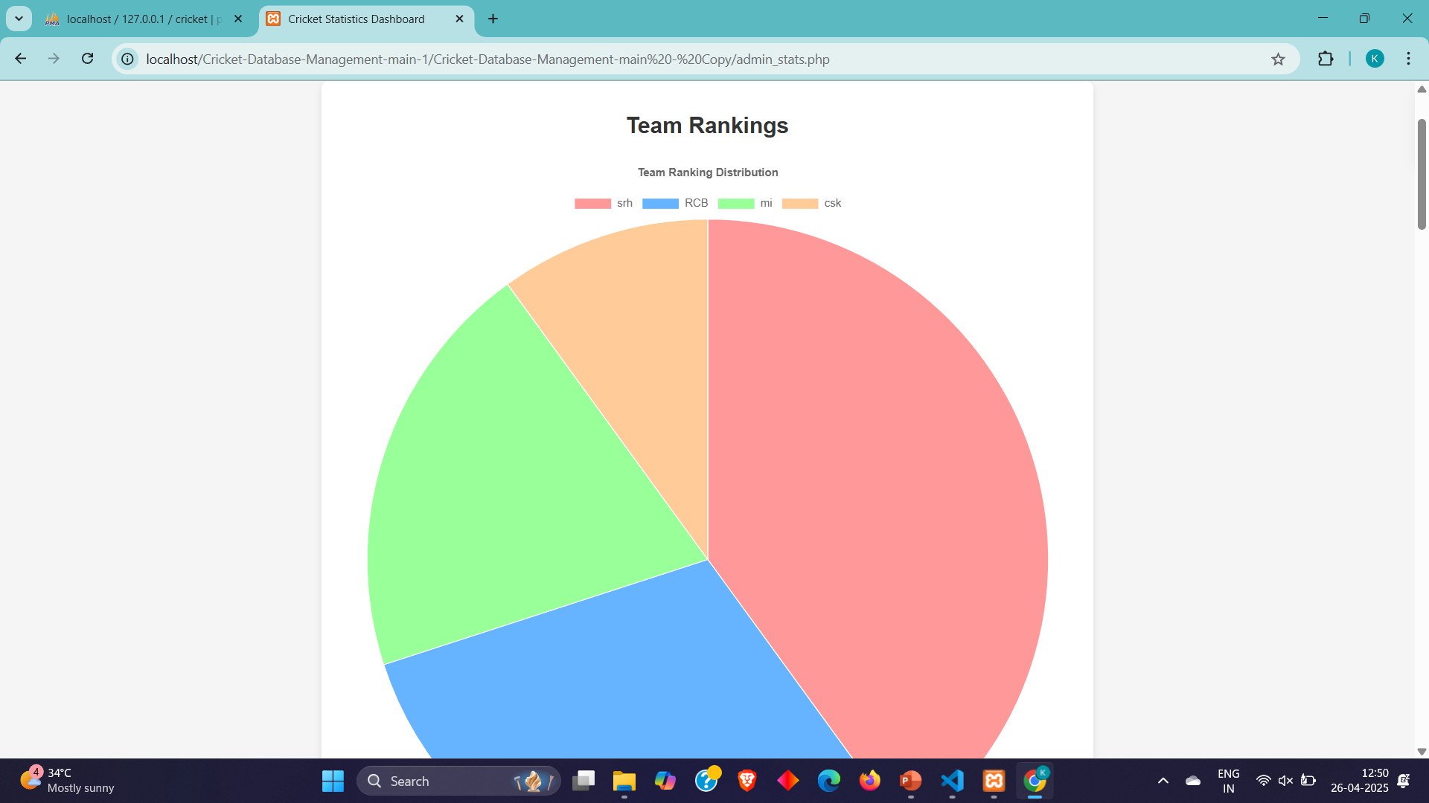
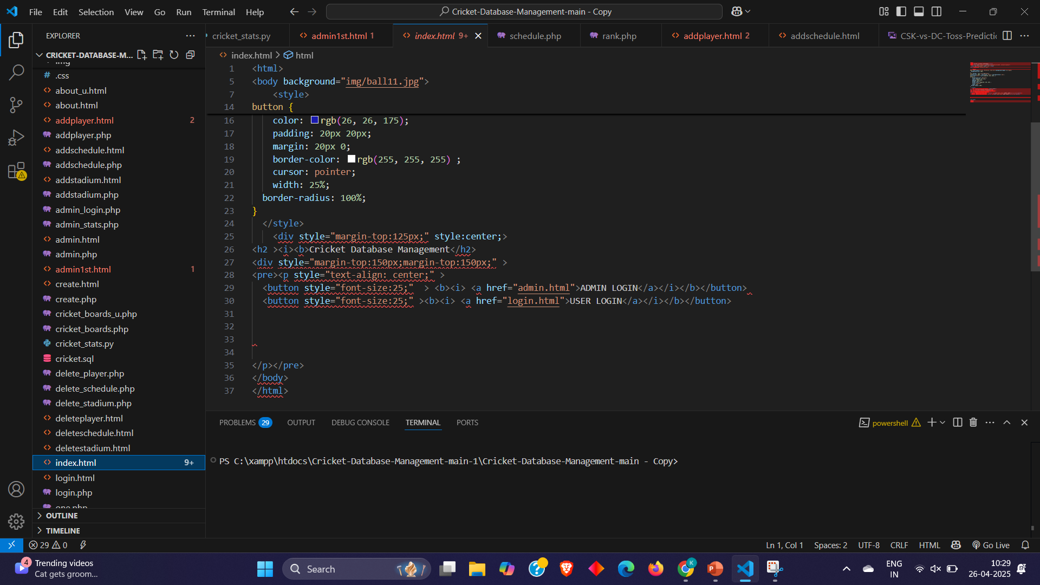
Implementation

Slide 10
Thank you!

